Slide 1

ChatBot 1
Teoh Teik Toe
ITOM/NBS
ttteoh@ntu.edu.sg
Aug 2020
97905202

Slide 2
Agenda
Create a simple MSBA FAQ chatbot using Snatchbot
Launch in Telegram

Slide 3
Chatbot

Slide 4
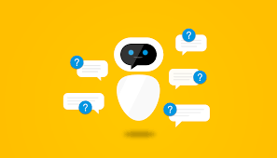
Chatbot
A chatbot is a software application used to conduct an on-line chat conversation via text or text-to-speech, in lieu of providing direct contact with a live human agent.

Slide 5
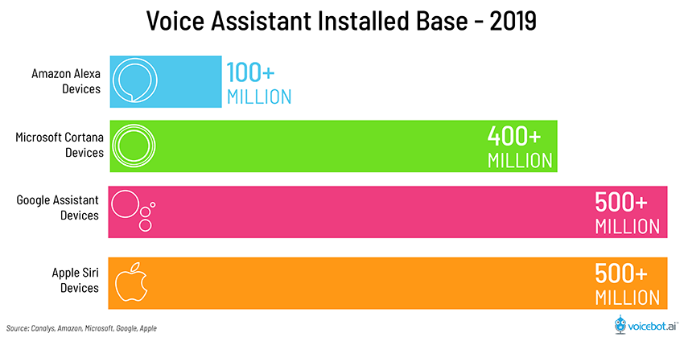
Chatbot Market

Slide 6
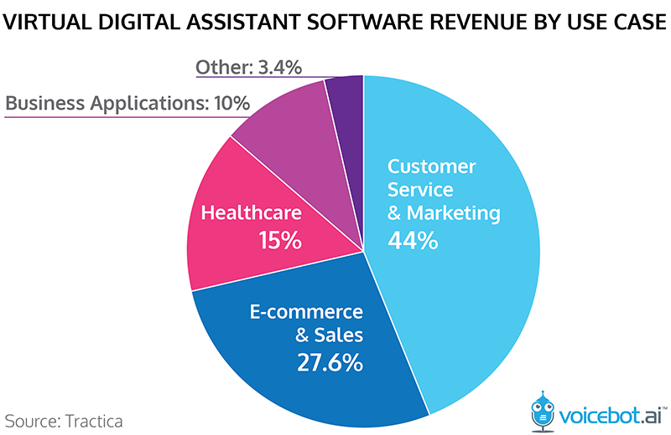
Chatbot Market

Slide 7
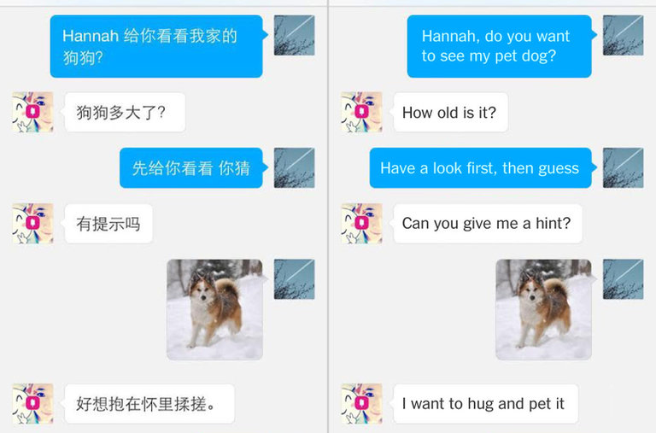
Microsoft’s Little Ice, XiaoIce in Chinese, became a social media phenomenon

Slide 8
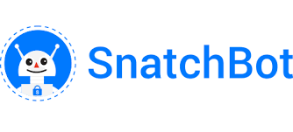
Snatchbot
SnatchBot was founded in 2015 by Henri Ben Ezra and Avi Ben Ezra as part of the flood of technological innovations and startups that come from Israel , more precisely Herzlia Pituach .
In July 2017, Snatchbot was one of the sponsors of the Chatbot summit in Berlin . By December 2017, more than 30 million users had contacted chatbots that were created on the SnatchBot platform.

Slide 9
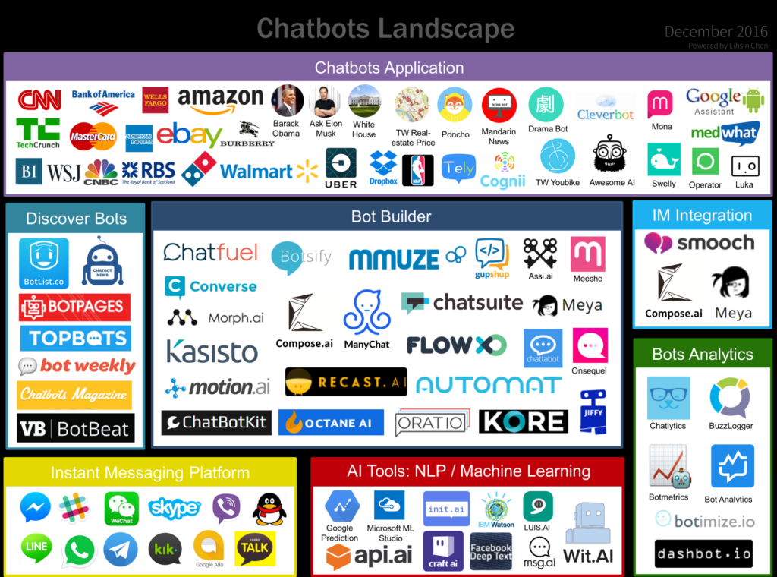
Chatbot Tools Market

Slide 10
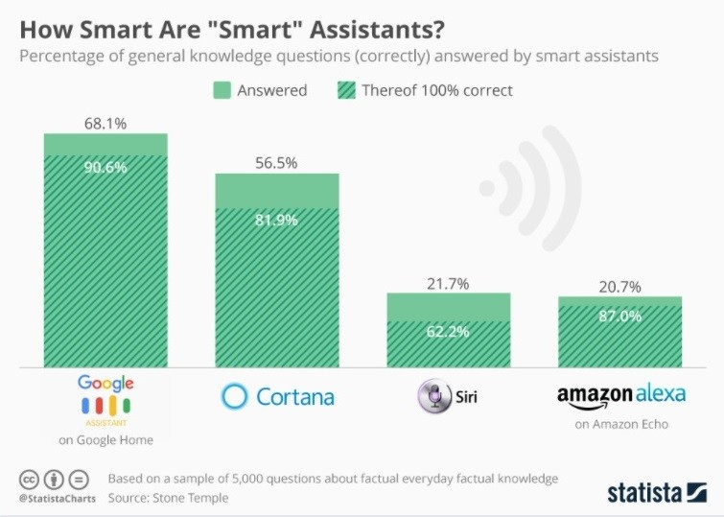
Accuracy of Chatbot

Slide 11
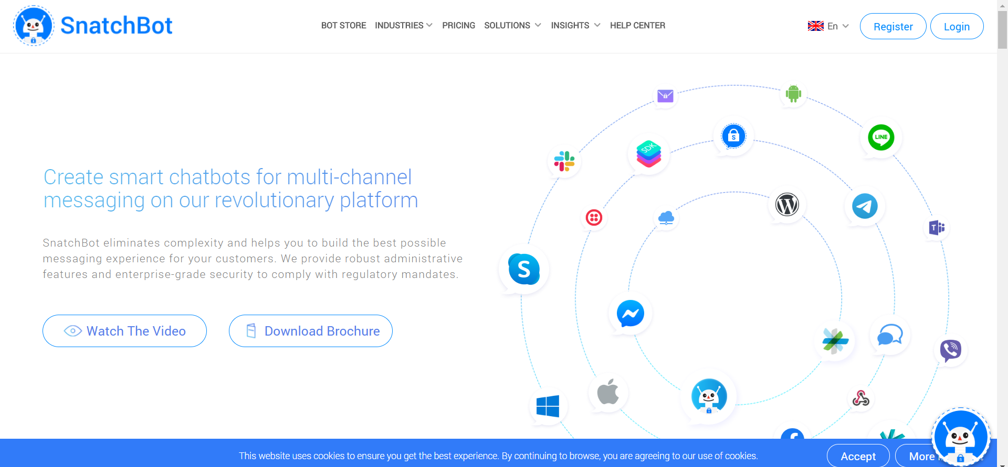
Snatchbot registration
go to https://snatchbot.me/
Click Register

Slide 12
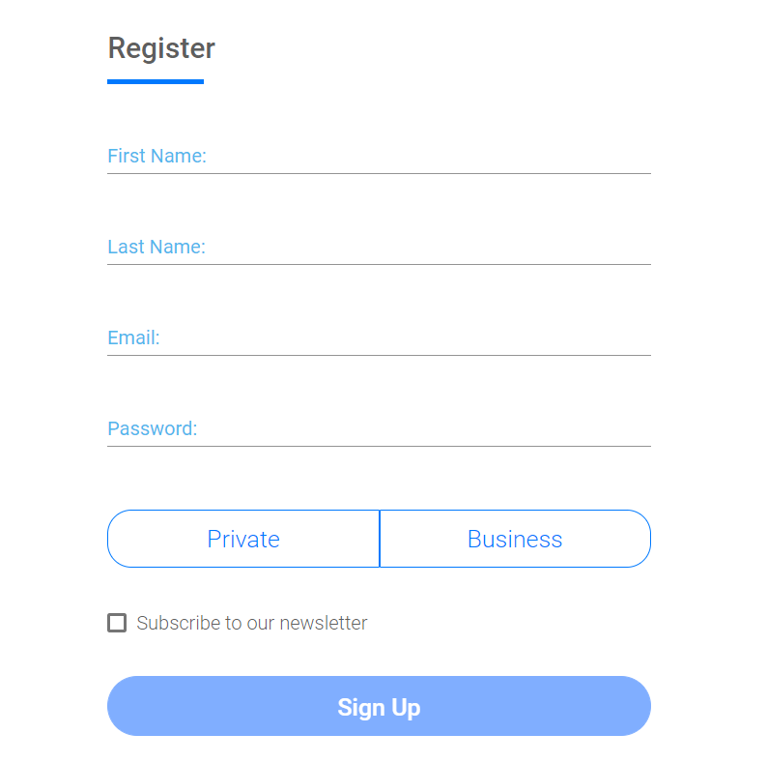
Snatchbot registration
Key in your details and click sign up

Slide 13
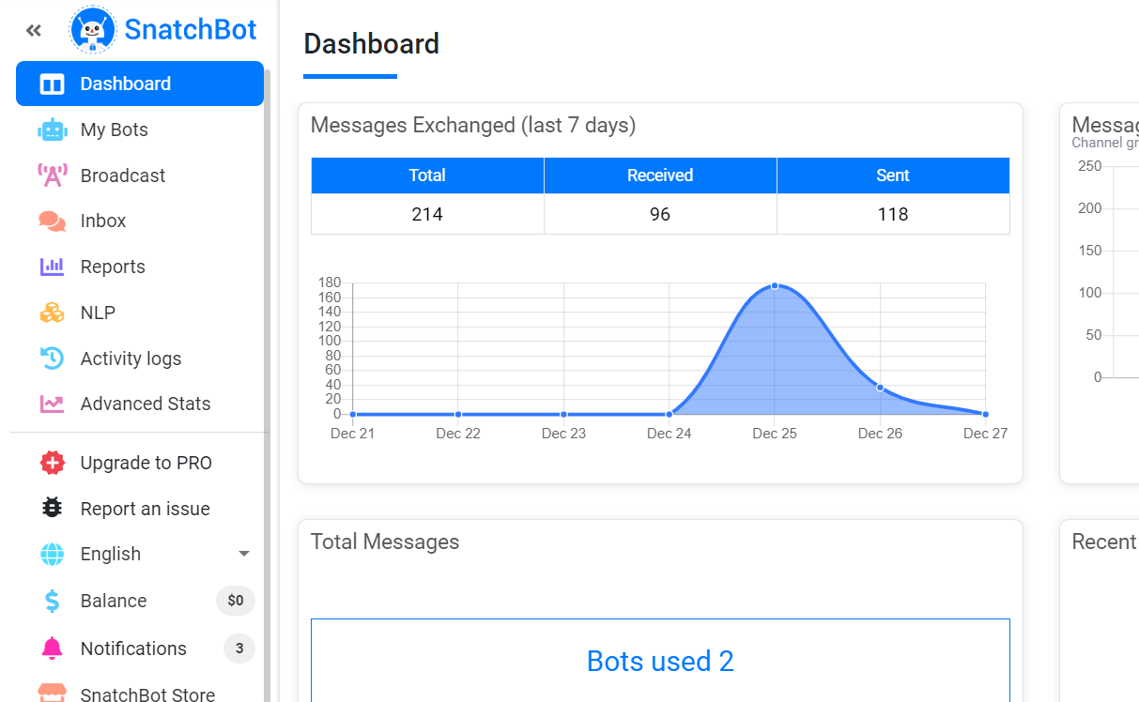
Creating a simple chatbot
Click on My Bots in the side menu

Slide 14
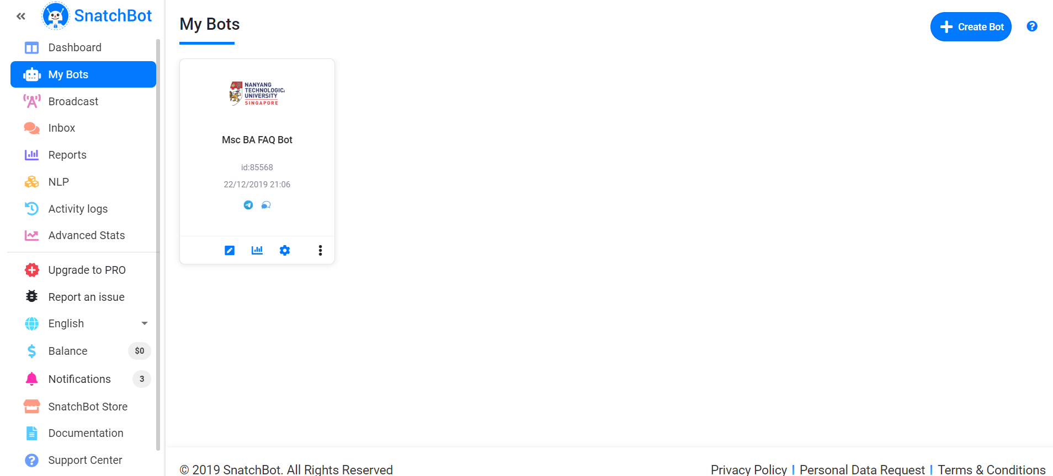
Creating a simple chatbot
Click Create bot

Slide 15
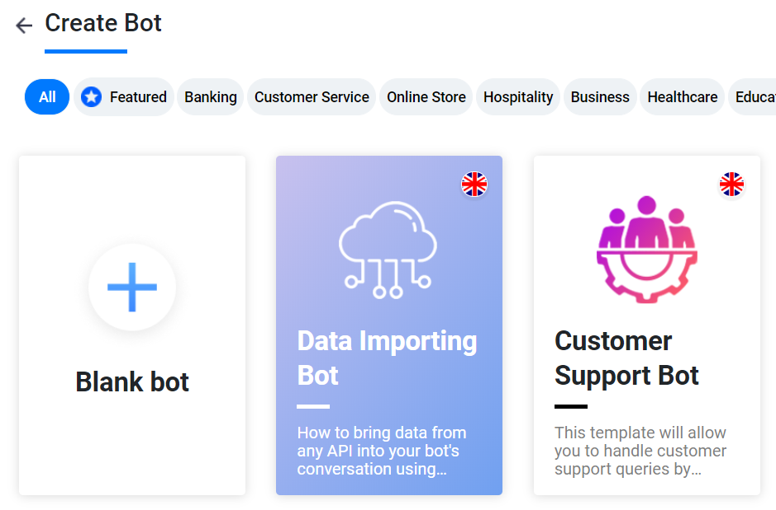
Creating a simple chatbot
Click on Blank Bot

Slide 16
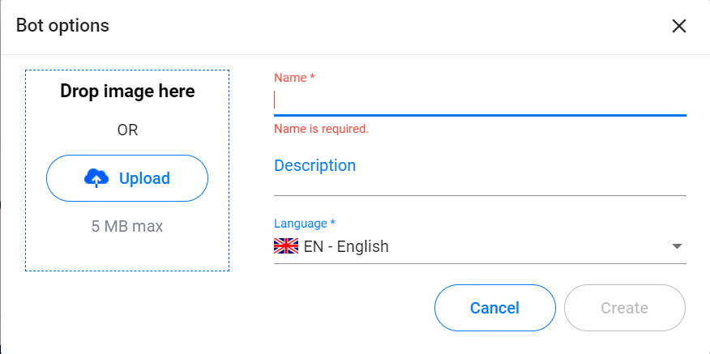
Creating a simple chatbot
Upload an icon image of your bot
Fill in the name, description and language of your bot
Select Create

Slide 17
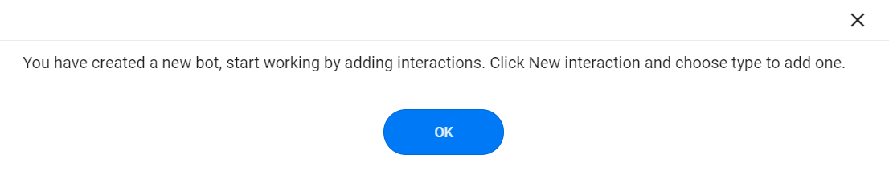
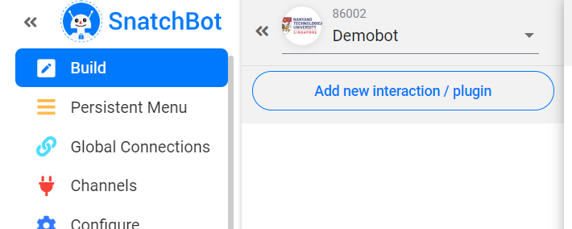
Creating a simple chatbot
Click ok on the message box
Click Add new interaction/ plugin

Slide 18
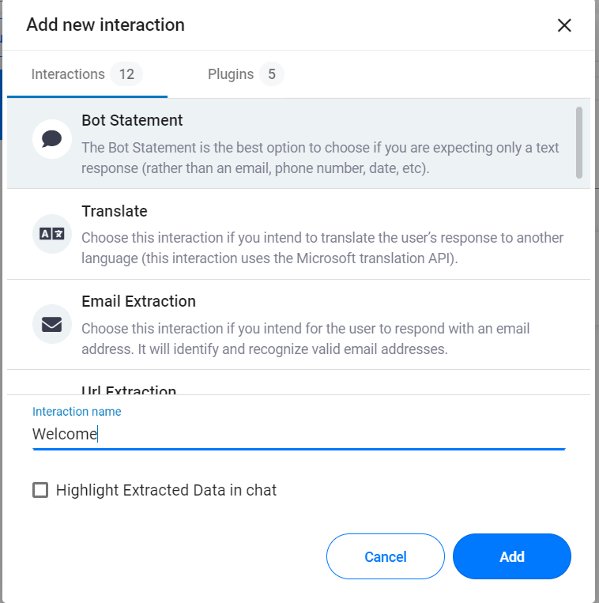
Creating a simple chatbot
Select Bot Statement
Name it “Welcome”
Click Add

Slide 19
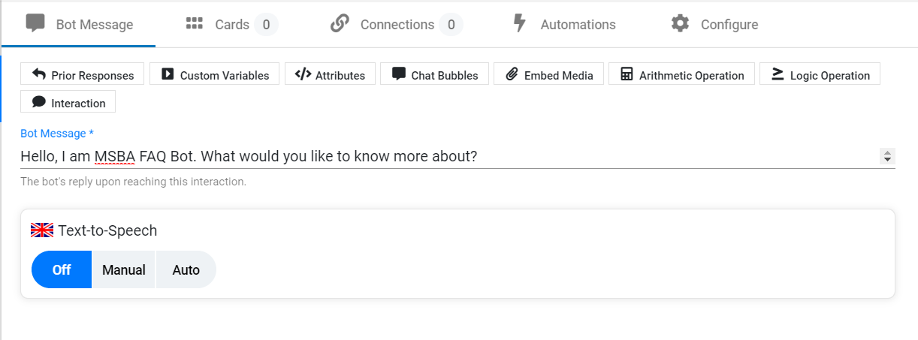
Creating a simple chatbot
Under Bot Message, type in a welcome message such as “Hello, I am MSBA FAQ Bot. What would you like to know more about? ”

Slide 20
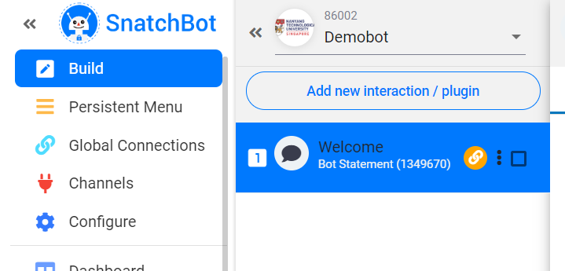
Creating a simple chatbot
Click Add new interaction/ plugin again to create another interaction

Slide 21
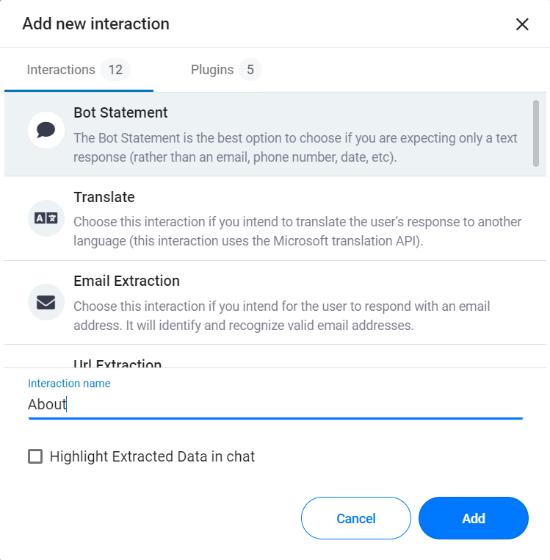
Creating a simple chatbot
Select Bot Statement
Name it “About”
Click Add

Slide 22
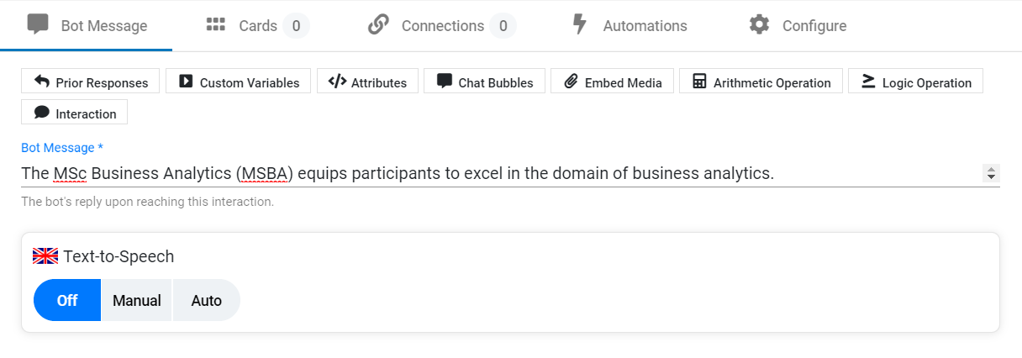
Creating a simple chatbot
Under Bot Message, type in a welcome message such as “​​In today’s digital world, organisations looking for new ways to engage their audience, reduce costs, increase profitability and improve risk management increasingly rely on business analytics to guide their strategic decisions. Business analytics is the intersection of Business, Data science and AI, offering valuable opportunities for data-driven competitive advantage”

Slide 23
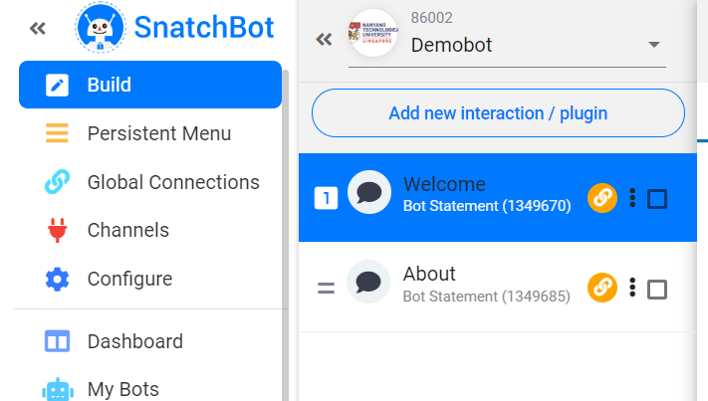
Creating a simple chatbot
Click back on the Welcome interaction

Slide 24
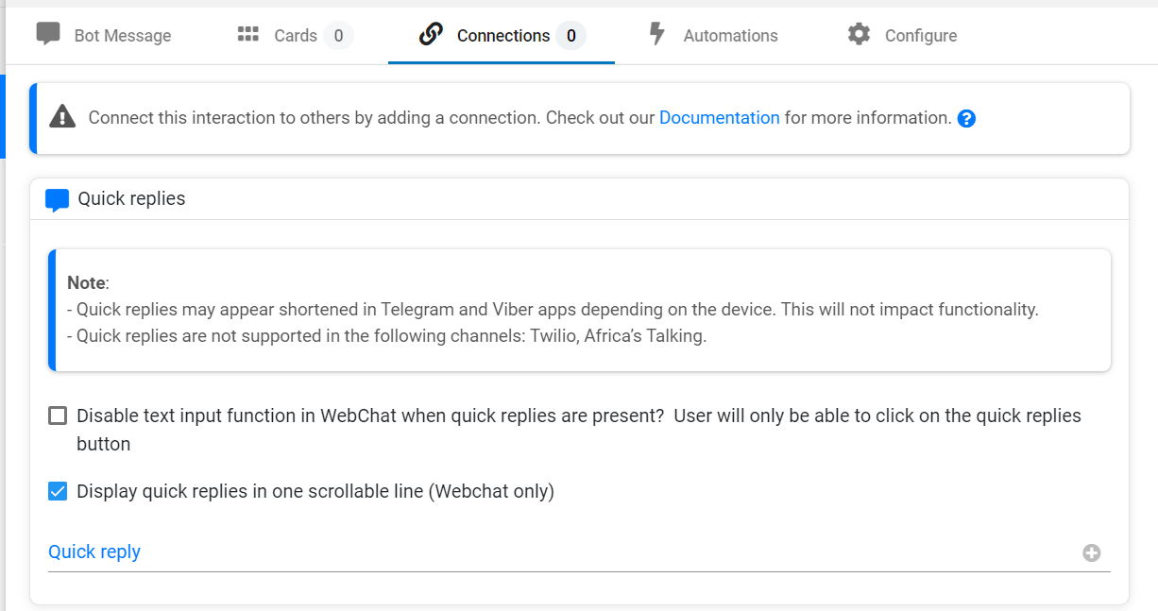
Creating a simple chatbot
Select Connections in the header
Type in “About” under quick reply
Click on the “+” icon

Slide 25
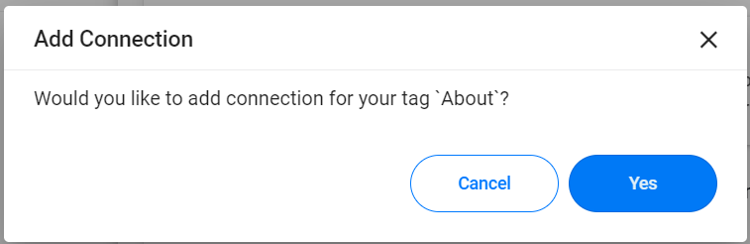
Creating a simple chatbot
Select “Yes”

Slide 26
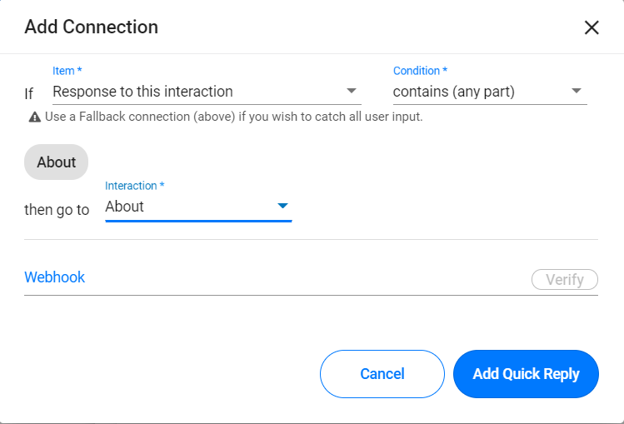
Creating a simple chatbot
Under Item, select “Response to this interaction”
Under condition, select “contains (any part)”
Under interaction select “About”
Click Add Quick Reply

Slide 27
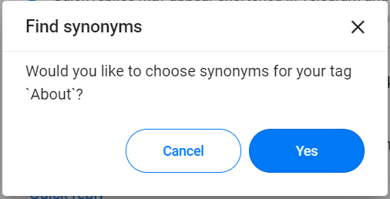
Creating a simple chatbot
Select Yes

Slide 28
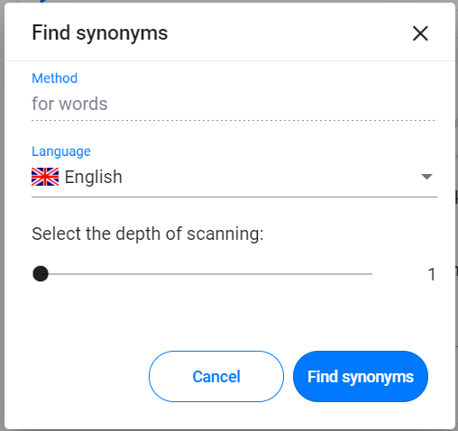
Creating a simple chatbot
Click on Find Synonyms

Slide 29
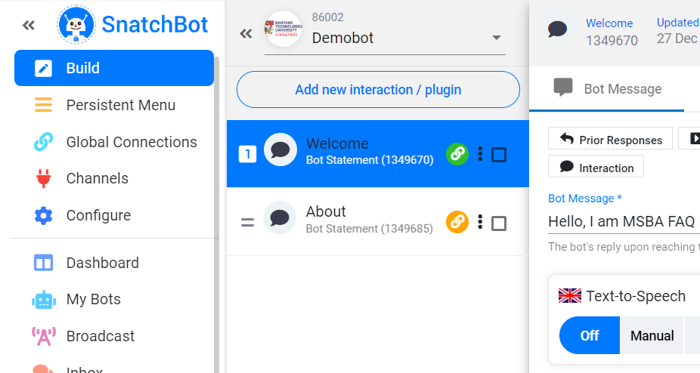
Creating a simple chatbot
Click Add new interaction / plugin

Slide 30

Creating a simple chatbot
Select Bot Statement
Name it “No Response”
Click Add

Slide 31
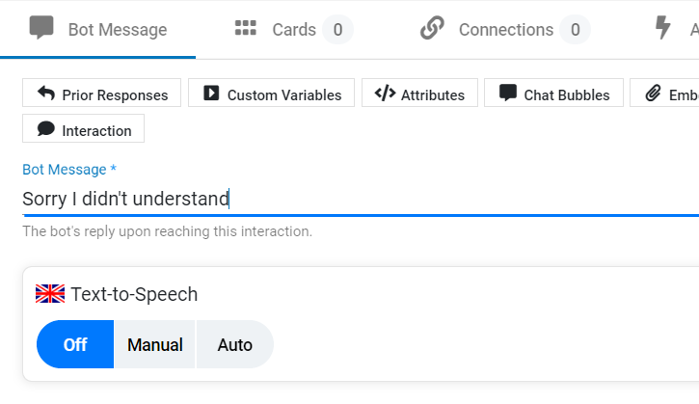
Creating a simple chatbot
Type “Sorry I didn't understand, please email us at MSBA@ntu.edu.sg” in the message.

Slide 32
Creating a simple chatbot
Select Connections in the header
Type in “Home” under quick reply
Click on the “+” icon

Slide 33
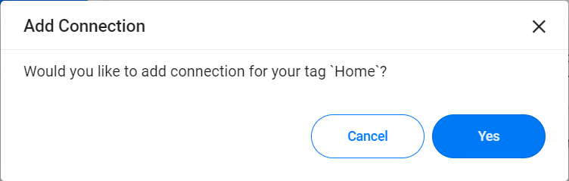
Creating a simple chatbot
Select “Yes”

Slide 34
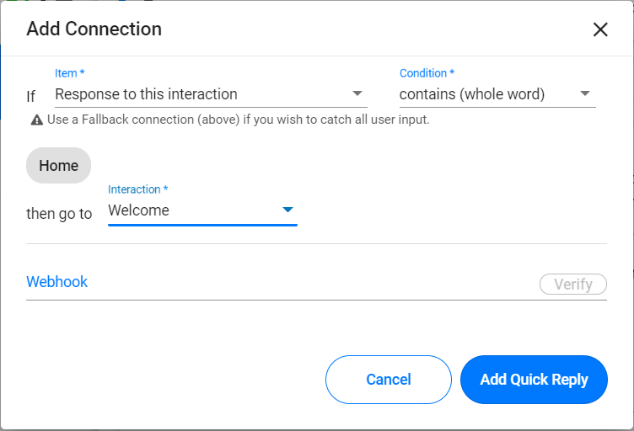
Creating a simple chatbot
Under Item, select “Response to this interaction”
Under condition, select “contains (any part)”
Under interaction select “Welcome”
Click Add Quick Reply

Slide 35
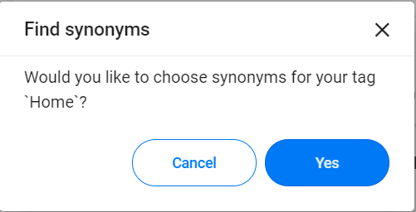
Creating a simple chatbot
Select Cancel

Slide 36
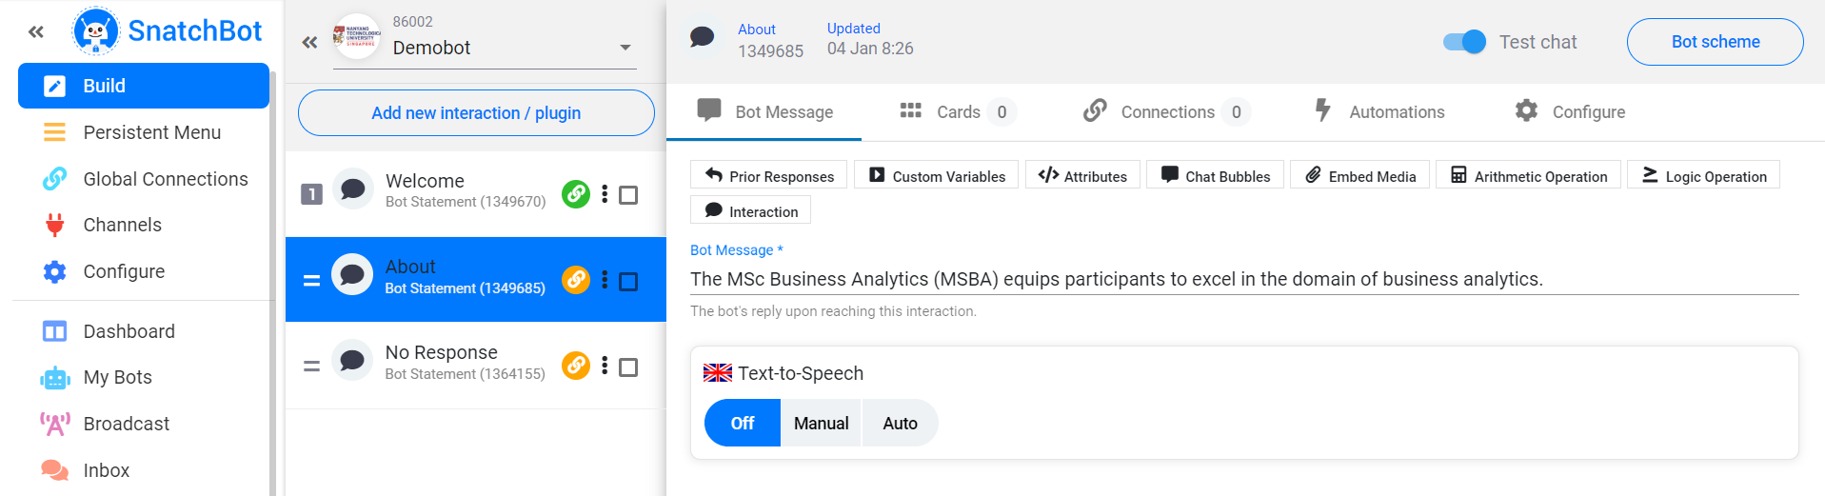
Creating a simple chatbot
Click About

Slide 37
Creating a simple chatbot
Select Connections in the header
Type in “Home” under quick reply
Click on the “+” icon

Slide 38
Creating a simple chatbot
Select “Yes”

Slide 39
Creating a simple chatbot
Under Item, select “Response to this interaction”
Under condition, select “contains (any part)”
Under interaction select “Welcome”
Click Add Quick Reply

Slide 40
Creating a simple chatbot
Select Cancel

Slide 41
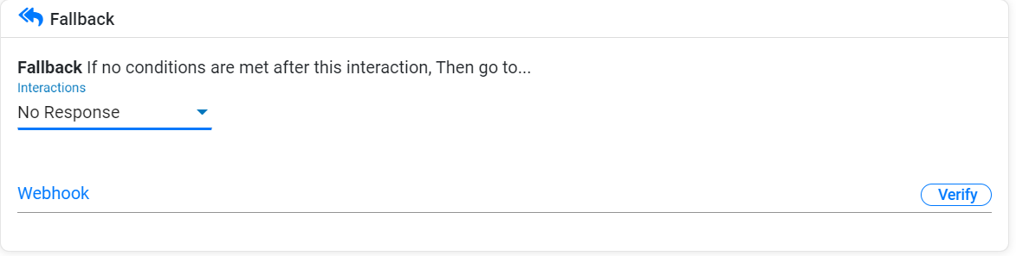
Creating a simple chatbot
Under Fallback, select No response

Slide 42
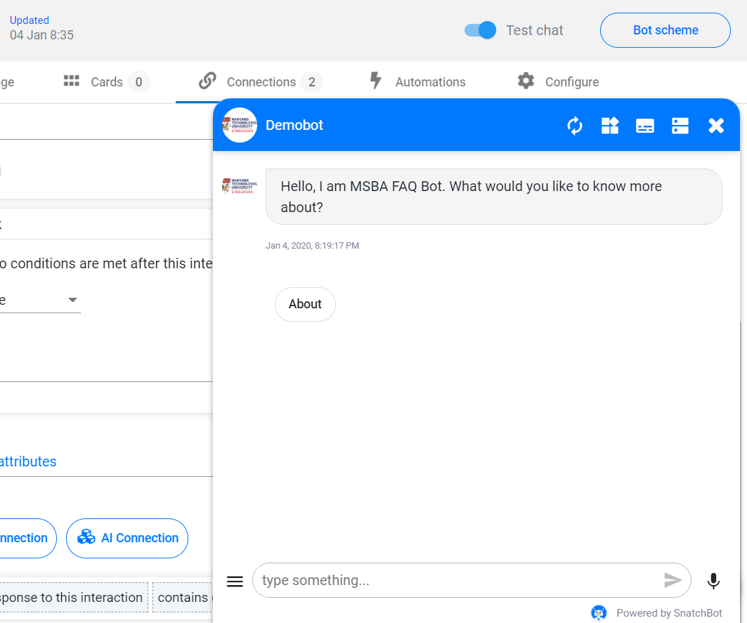
Creating a simple chatbot
The chatbot is done!
Click on the tiny icon at the bottom right
refresh to update the chatbot
begin chatting

Slide 43
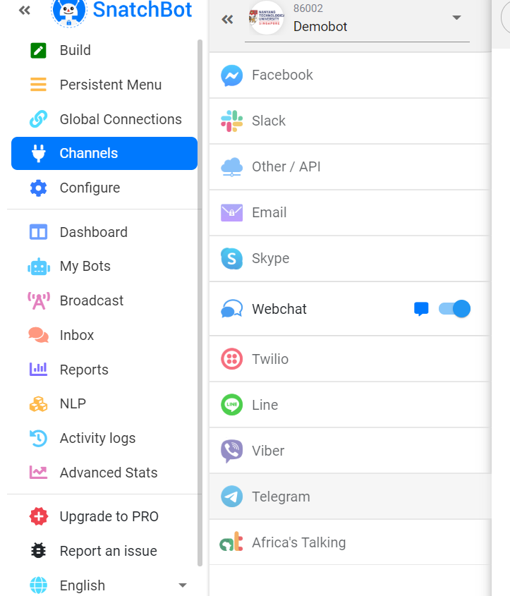
Deploying the chatbot on telegram
Click on channels
Click on telegram

Slide 44
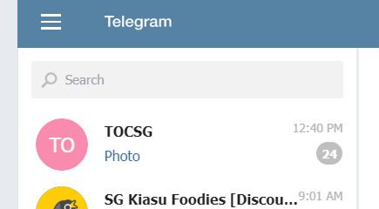
Deploying the chatbot on telegram
Download telegram
Create an account
Go to telegram web at https://web.telegram.org/
Type BotFather in the search bar

Slide 45
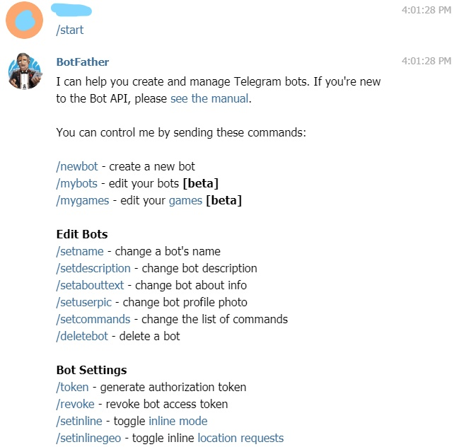
Deploying the chatbot on telegram
Click on the start button or press /start

Slide 46
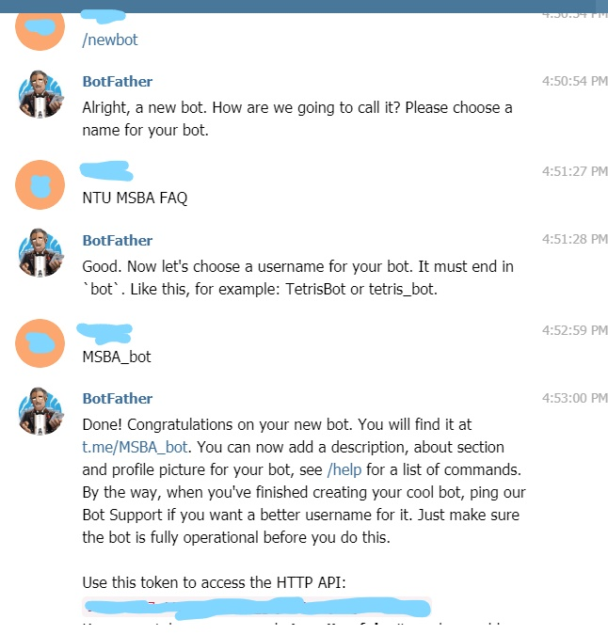
Deploying the chatbot on telegram
Type /newbot
Type the name of your telegram bot in our example it is “NTU MSBA FAQ”
Type the unique telegram username for your bot in our example it is “MSBA_bot”
Copy the token

Slide 47
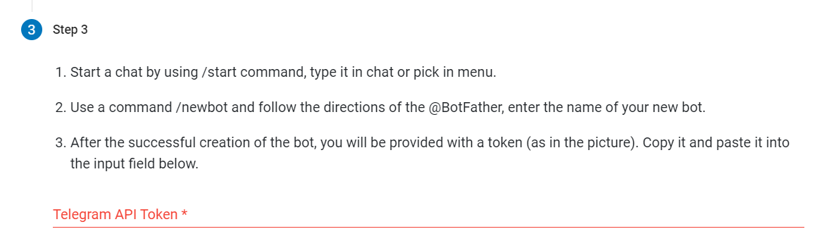
Deploying the chatbot on telegram
Go back to snatchbot and scroll down to click on step 3.
Paste the Telegram API token

Slide 48
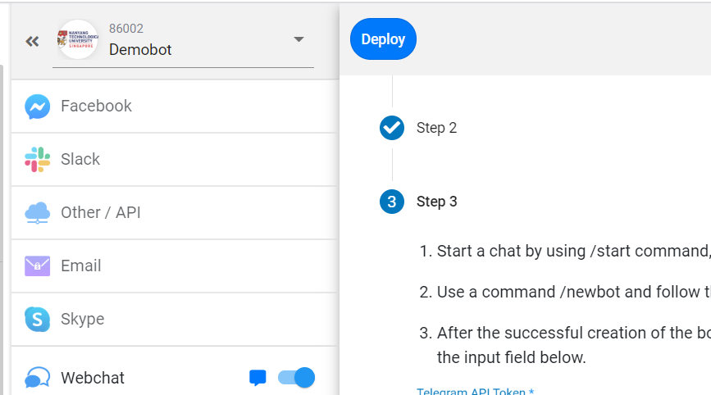
Deploying the chatbot on telegram
Click Deploy

Slide 49
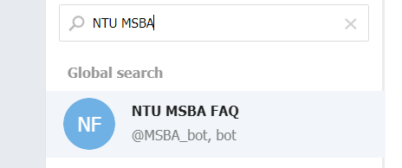
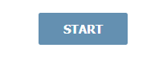
Finding chatbot on telegram
In the telegram search bar type in the name of your telegram bot and find it.
Click on your telegram bot
Press start to begin chatting

Slide 50
MSBA Example

Slide 51
Exercise
Create a simple Chatbot base on your choice of FAQ
Present your chatbot

Slide 52
Presentation and Discussion
Individual Project 30%
Project Plan 5% (Week 5)

Slide 53
Recap
What are some the successful examples of chatbot?
What can Snatchbot do?
Why chatbot is so important today?

Slide 54
Resources
https://www.youtube.com/watch?v=yTPrs5lYgnA
https://www.youtube.com/watch?v=1vQLArE8xVw
https://www.youtube.com/watch?v=Fz7_0IxfJBw&t=16s
https://www.youtube.com/watch?v=1swBBSCrMkA

Slide 55
Thank You

